Slide 1
Recommender Systems – A Primer
Pablo Castells
pablo.castells@uam.es
Dietmar Jannach
dietmar.jannach@aau.at

Slide 2
Recommender Systems – A Primer
Accompanying slides for
Castells, P., Jannach D., Recommender Systems: A Primer, in: Alonso, O. and Baeza-Yates, R. (eds.): Advanced Topics in Information Retrieval, ACM, 2024
Preprint available at:
https://arxiv.org/abs/2302.02579

Slide 3
Recommender Systems
Automated recommendations are omnipresent
Netflix, Spotify, Amazon, LinkedIn, Instagram, Facebook, Twitter, TikTok …
Recommender Systems (RS)
Systems that determine the most suitable content to present to users
Based on statistics and machine learning
Recommendations often made in a personalized way

Slide 4
Recommender Systems
A very visible success story of machine learning
e.g., TikTok, which is mainly a recommender system
RS create value for various stakeholders
Businesses and consumers
A highly dynamic and active field of research
high demand in industry
fueled by constant progress in machine learning

Slide 5
History
Roots and relationships with Information Retrieval (IR)
Main IR success example: Search engines (Google)
IR mostly based on search queries
RS learn interests from user behavior instead
Roots of modern RS in 1990s: Tapestry
A personalized email filtering system (1992)
Introduces the idea of collaborative filtering
Rely on opinions of others when filtering
“Show me content that John liked”

Slide 6
History
Roots of modern RS in 1990s: GroupLens
Automated the idea of collaborative filtering (1994)
Based on the identification of like-minded users (neighbors), based on their past ratings
Predict rating for new content based on neighbor opinions
Recommendation as “matrix filling/completion”
Matrix filling as a predominant research operationalization
Today: Mostly based on deep learning

Slide 7
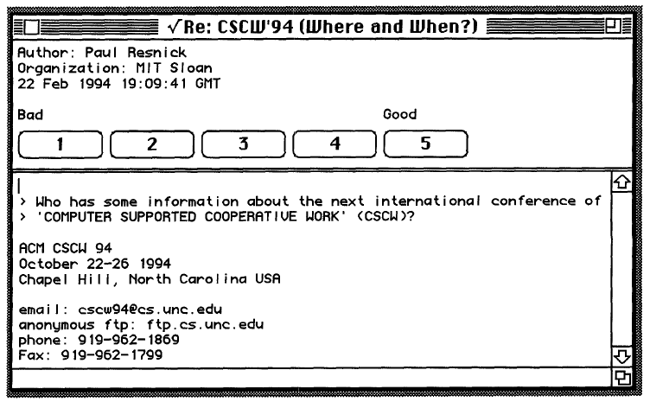
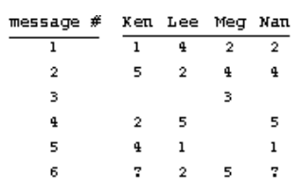
GroupLens
Rating interface and rating matrix
Goal is to predict the empty cell values

Slide 8
History
Roots of modern RS: content-based filtering
Filter and rank items based on their content (e.g., the actual news message)
Ranking based on similarity of content to the content the individual user liked in the past
Based on IR methods
e.g., document encoding/representation, similarity functions
Hybrids
Combine different approaches
e.g., collaborative filtering with side information

Slide 9
History
First industry success in late 1990s
e.g., in e-commerce and music
Amazon as an early adopter
provide recommendations at scale
Today:
Wide-spread use of recommendations in industry
A highly active academic research field
Own conference series and journal on recommenders
Still many open challenges and opportunities

Slide 10
The Recommendation Task
Main task is to determine which items to show to a user in a given situation
Central questions, depending on application
What criteria to use for filtering and ranking?
The chosen criteria depend on the following
What is the purpose of the system?
How should it create utility or value for different stakeholders?

Slide 11
The Value Perspective
Various forms of value possible
Both for consumers and providers
Possible consumer value:
Reduce information overload, help people find relevant content
Possible provider value:
Improve Key Performance Indicators, e.g., sales volume or customer retention
Academic research commonly abstracts from such specifics
Driven by interest in designing application-independent solutions

Slide 12
Abstract Problem Characterization
An abstract computational task:
Compute an estimate of the absolute or relative relevance of individual items for a given user
A common formalization:
Given a set of users U, a set of items I, a utility function (which maps users and items to a utility value)
Recommend the item(s) with the highest utility

Slide 13
Abstract Problem Characterization
Given this characterization:
Algorithmic research in RS aims to define or learn the utility function f
The utility function f can be based on various types of information
Learning f in collaborative filtering systems
Nearest-neighbor approach in early systems
All sorts of machine learning approaches were applied to learn f from the noisy data in the user-item matrix
Today: deep learning

Slide 14
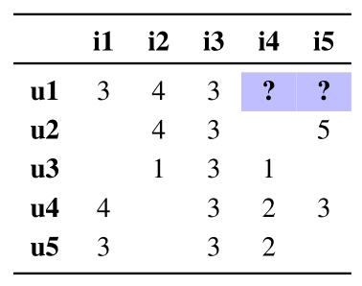
The User-item Rating Matrix
Since the early GroupLens system
Operationalized goal
Predict the values in the empty places in the matrix
Many types of models can be applied
Leveraging additional data
Various sorts of side information may be incorporated

Slide 15
Explicit and Implicit Feedback
From GroupLens (1994) to the Netflix Prize (2006-2009):
Matrix is assumed to be filled with explicit user ratings, e.g., from one to five stars
Today:
Mostly “implicit feedback” is assumed to exist
E.g., a purchase is considered a positive rating in e-commerce
This feedback is also mostly positive
Requires interpretation and can be noisy
Not having purchased item may not be a negative signal

Slide 16
Adding Context
Any sort of information can be added to f
Context is a popular factor in the literature
Context describes the current situation of the user
geographical position, time, weather, social environment
Utility (e.g. of a given restaurant) may largely depend on the context
Leads to extended utility function

Slide 17
From Rating Prediction to Ranking
Individual rating prediction not too relevant in practice
Instead, ranking the items is the focus today
Leading to the top-N recommendation task
Ranking can be achieved:
by sorting individual ranking predictions
through learning-to-rank algorithms
Leading to a list optimization problem
where L* is the set of all item permutations up to size N

Slide 18
Item and List Utilities
What is the utility, we seek to optimize?
In GroupLens: Utility = Rating
Recommend items with highest predicted rating
In reality, we could also consider provider utility
Item utility vs. list utility
Historically, item-wise utility assessment was the focus
This, however cannot capture quality aspects that relate to the entire list
e.g., the overall diversity of the list

Slide 19
Recommendation Algorithms
Recommendation as a supervised machine learning problem
Given examples of observed user choices
Learn parameters of a utility function f which minimizes a cost function
Cost function could be the squared prediction error; or a binary cross-entropy loss to quantify the ranking error
Predict present or future user interests
Distinguishing algorithms
(i) by form of the utility function (parameterized model), (ii) cost function, (iii) optimization approach

Slide 20
Recommendation Algorithms
An example utility function
Dot product (similarity) between user- and item embeddings
Where embeddings are low-dimensional representations of objects in the form of vectors of real-valued numbers,
and where the embeddings are parameters of the model to be learned
The model is a choice from a family of functions (the hypothesis space)
Model parameters are learned based on training
by minimizing the cost function
Additional hyperparameters may have to be tuned

Slide 21
Categorization by Type of Input
A particularity of the learning problem
There is a human factor at the core
Vagueness and “noise” in user behavior and preferences
It is also not only about predicting preferences, but also to enhance/change user actions
Not objectively clear what’s a good recommendation
Difference to other applications of machine learning where some “ground truth” is known
e.g., categorization of images, extraction of keywords or named entities from text

Slide 22
Categorization by Type of Input
Collaborative filtering:
Based solely on logged user-item interactions, among the most powerful approaches
Based on abstract principle that people can benefit from the experience and discoveries of other people
Achilles heel:
Problems when the interaction matrix is sparse (cold-start situation)
Using side information:
Incorporate different types of information, in particular in sparse regions of the matrix

Slide 23
Categorization by Type of Input
Content-based filtering:
Rely solely on information about items, and the past preferences of the individual (“target”) user
Relevant item features are termed “content” for historical reasons
Hybrid systems (in terms of inputs):
Various other types of external information can be incorporated
Social interactions between users, user demographics, context information (time, weather, user device, …)

Slide 24
Collaborative Filtering Algorithms
Nearest-Neighbors
Inspired by word-of-mouth behavior, where people take advice from trusted friends
k-nearest-neighbor (kNN) approaches make predictions based on the weighted average of the advice by similar other users (neighbors/peers)
Recommendation viewed as a regression problem
predicted level of preference for user u based on linear combination of preferences of selected other users N[u]

Slide 25
Collaborative Filtering Algorithms
Nearest-Neighbors
Utility function as weighted sum
C_{i} as a normalization term
indicates that a neighbor rating exits
is a similarity function between users
e.g., cosine similarity, Pearson similarity

Slide 26
Collaborative Filtering Algorithms
Nearest-Neighbors
Normalization term, e.g., to scale prediction to rating scale
k, the number of neighbors, is a hyperparameter
Variations of the kNN scheme
Item-based kNN: Swap roles of users and items
Neighborhood selection, similarity functions

Slide 27
Collaborative Filtering Algorithms
Nearest-Neighbors – in sum
Old idea, conceptually simple
Naïve implementation may not too scalable, but can be engineered
Still a competitive approach today in some applications
Should be considered as a baseline in algorithm comparisons

Slide 28
Collaborative Filtering Algorithms
Matrix factorization
Assumes that interests of users can be described in a low-dimensional space of latent factors
Users and items are described as vectors in a common latent factor vector space
Similar users have similar vectors; same for items
Such vectors (e.g., of size 64) are called embeddings
Latent factors have no direct real-world correspondence, e.g., with item properties, and are not interpretable. They are dimensions in a multi-dimensional space
Number of factors is a hyperparameter to determine

Slide 29
Collaborative Filtering Algorithms
Matrix factorization
In a k-dimensional space, users and items are represented as vectors p and q:
Coordinates express the interest of user u in dimension z, and how much factor z is present in I
Assumption: Interest of user u in item i can be captured by the dot product of the latent vectors

Slide 30
Collaborative Filtering Algorithms
Matrix factorization (MF)
Producing the latent factors done by minimizing of a cost function R (risk/expected loss), which involves the error in predicting the training data
|| .|| is the L2-norm for regularization, to avoid overfitting; λ is a hyperparameter
Squared error
Regularization term

Slide 31
Collaborative Filtering Algorithms
Matrix factorization
Optimization done, e.g., by stochastic gradient descent
Ranking of items based on the dot product of user and item vectors
Many variations and extensions proposed, e.g.,
bias terms for users and items
temporal factors
…

Slide 32
Collaborative Filtering Algorithms
Learning to Rank (LTR)
Item ranking found to be more important than point predictions
Introduction of a loss/cost function that involves item ordering (rather than rating prediction error)
The cost function represents the amount of “contradiction” between predicted/learned ranking and the training data
Mostly following a “pairwise” approach, error defined as number of incorrectly ranked pairs

Slide 33
Collaborative Filtering Algorithms
Learning to Rank (LTR)
Pairwise loss function
Θ are the parameters of the recommendation model
quantifies the contradiction and involves the utility
Summed over all pairs of items where training data exists
Bayesian Personalized Ranking (BPR) as a common example
Based on the probability that the scores by the model are in contradiction to the training data

Slide 34
Collaborative Filtering Algorithms
Bayesian Personalized Ranking
Probability of ranking precedence is smoothed as a logistic sigmoid of the ranking score difference
Assume a MF model, with
Optimization via gradient descent
Can be seen as layer on top of MF

Slide 35
Collaborative Filtering Algorithms
Neural recommendation, deep learning (DL)
MF: uses dot product as linear utility scoring function
Not designed to capture complex, non-linear relationships
Deep learning (neural) techniques very successful in many application areas of machine learning
Promise also in recommender systems
Ability to approximate any prediction function
Easy to integrate various types of data
Less need for feature engineering
Availability of software libraries

Slide 36
Collaborative Filtering Algorithms
Neural recommendation
Rapid adoption of DL for recommendation around 2015
Nowadays considered the state-of-the-art approach, both in academia and industry
All sorts of network architectures explored, e.g., multi-layer perceptron, autoencoder, convolutions, recurrent neural networks, transformer, …
Progress paradox
Certain hype led to rushed evaluations using untuned baselines in the beginning
Actual progress not always clear

Slide 37
Collaborative Filtering Algorithms
Neural recommendation
Often best choice when large amounts of data and side information are available
May also help reduce feature engineering efforts
DL approaches can however also be challenging for different reasons
Computational complexity
Extensive hyperparameter search, or even architecture search needed
Black-box nature of the models (limited interpretability and explainability)
Nonetheless a thriving area

Slide 38
Content-based and Hybrid Recommenders
Collaborative Filtering, as discussed, can be highly effective without requiring information about the items themselves
However, often such information is available
It may make sense to consider this information
Assume that we know the preferred movie genres of the user
It is only intuitive to recommend more of that genre
In particular when there is little interaction information for the user or the item available (user cold-start, item cold-start)

Slide 39
Content-based and Hybrid Recommenders
Pure Content-based Systems
Consider preferences on a user-individual basis
Formal characterization
predicted user-item relevance f based on a scoring function, which matches the content-based preference profile of user u with the content features of item i

Slide 40
Content-based and Hybrid Recommenders
Pure Content-based Systems
Can be implemented in various ways
Assuming that textual descriptions of the items are available
Traditionally, these documents are TF-IDF (Term-Frequency Inverse Document Frequency) encoded
The function Content(i) would thus return a real-valued vector of importance values for the terms in the document
TF-IDF value is the multiplication of TF and IDF
TF indicates how often a term appears in a document, normalized for document length
IDF indicates how informative the term is in a given document collection. Terms that appear everywhere carry little information

Slide 41
Content-based and Hybrid Recommenders
Pure Content-based Systems
How to implement ContentBasedProfile(u)?
Could encode all “liked” documents of a user via TF-IDF
User profile could then be the average of the vectors
The score function to match items with the user’s past profile could then be the dot product
Various implementation variants possible
Today, documents are often represented as semantic embeddings (distributed representations)
Various types of exogenous information, e.g., from Wikipedia can be integrated

Slide 42
Content-based and Hybrid Recommenders
Pure Content-based Systems
Specific application use cases, e.g.,
When constantly new items appear (e.g., in the news domains), for which not sufficient information is available
When the general user preferences are rather stable over time
When providing “similar item” recommendations
Certain limitations
By design recommend “more of the same”, leading to limited discovery
May also surface content that is too niche

Slide 43
Content-based and Hybrid Recommenders
Hybrid recommender systems
Rely on more than one paradigm (type of inputs)
Combine advantages of individual methods while avoiding their shortcomings
Trivial example for content-based recommendation
Remove all items that received a too low overall community rating

Slide 44
Content-based and Hybrid Recommenders
Hybrid recommender systems
Three main categories of hybrids
Monolithic: Different strategies are implemented in one algorithm, e.g., a model that considers both collaborative and content information
Parallelized: The outcomes of two or more algorithms are first computed independently and then combined, e.g., weighted. Switching strategies also fall into this category
Pipelined: The output of one algorithm serves as an input to the next, e.g., one could first filter candidates by popularity and subsequently rank the remaining ones

Slide 45
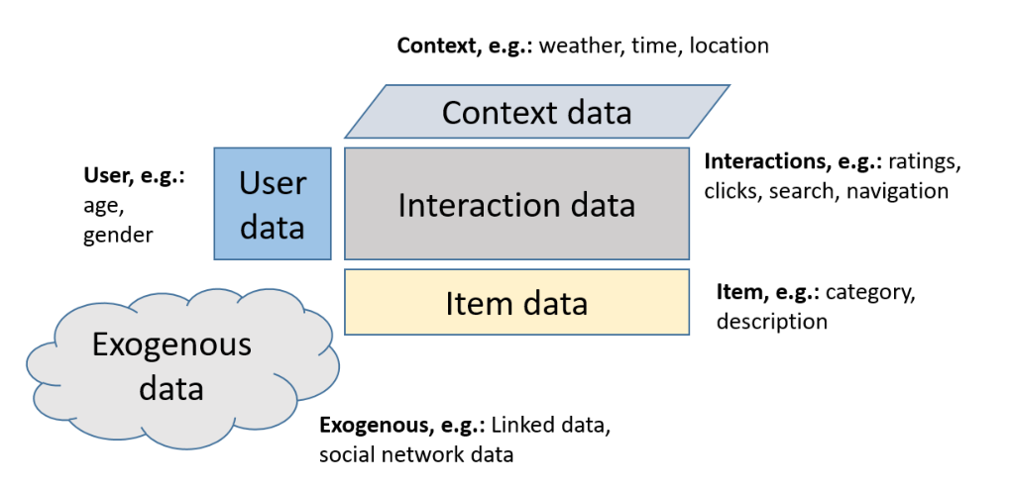
Content-based and Hybrid Recommenders
CF with side information
The most common hybrid approach
Side information not limited to item-related information

Slide 46
Content-based and Hybrid Recommenders
CF with side information
User data: Static or slowly changing, e.g., demographics such as age gender, nationality; also: personality traits
Item data: Dependent on application, can be pre-structured like categories, or unstructured such as descriptions, reviews or images
Context data: Various types of frequently changing context information, e.g., geographic position, time of the day, weather, end user device

Slide 47
Content-based and Hybrid Recommenders
CF with side information
Interaction data: Historically: Focus on ratings, nowadays various types of implicit feedback, e.g., item views, purchases, add-to-cart, search actions, later item returns; often including time stamps
Exogenous data: Inclusion of “world knowledge”, e.g., form Wikipedia or through Linked Open Data. User-individual exogenous data include the user’s social network or trust relationships
Recent focus on information-rich collaborative filtering
Many opportunities for (graph-based) neural network approaches

Slide 48
Discussion of Algorithms
Only discussed selected algorithms
other notable ones include Factorization Machines, Sparse Linear Models (SLIM) and EASE^{R} based on a shallow auto encoder
recent developments focus more on sequential recommendation problems
Generally, we recall that algorithms are just one component of a recommender system
albeit the most researched one in the literature

Slide 49
Evaluation of Recommender Systems
A large variety of algorithms exist
An informed choice requires reliable evaluation methodologies
Generally, evaluation involves a comparison of two or more systems or system variants
In industry: Online A/B (field) tests
Run two systems in parallel and compare effects after testing period
In academia (and industry): Offline evaluation
Based on historical data
Cheap to explore various algorithms and configurations

Slide 50
Online Evaluation
A standard approach in industry
Yet, A/B tests can be costly and risky
Offline evaluation often done in advance, before A/B testing
e.g., to filter variants that are assumed to be low-performing online
Procedure
Two systems, A and B, are compared online; sometimes more than two
Each system receives some fraction of the traffic
A is often called control (e.g., the existing system), B the treatment
Users are randomly assigned to one group, and participants are not aware of being in a group

Slide 51
Online Evaluation
A/B tests allow to measure effects of algorithms on business metrics (Key Performance Indicators), e.g.,
engagement (clicks, views, dwelling time), sales (revenue, profit, number of purchases), customer retention / churn
Tests are run until pre-defined time (e.g., one months) is reached or statistical significance
This may limit the number of tests that can be done in parallel
Risk of exposing customers to so far untested version
Offline evaluation may help pre-filter candidates to A/B test

Slide 52
Online Evaluation and Offline Evaluation
Online/Offline gap
Often weak or missing correlation between offline results and A/B tests
Yet, offline evaluation remains important selection yardstick before live tests
User/lab studies
Not necessarily based on a production system, but often on a prototype
Can be a solution to assess different quality aspects with the help of (representative) users, e.g.,
questions related to the quality perception
questions related to the user interface

Slide 53
Offline Evaluation
Can be seen as a simulation of the system
Different proxies (offline metrics) used to measure the system’s effectiveness
Usually based on a number of abstractions
Comparing offline and online
Online evaluation acquires user feedback after recommendations are delivered
In offline testing, the test data is collected before recommendations are produced; the made recommendations are actually never shown to users

Slide 54
Offline Evaluation
Offline evaluation might appear a simple task
Just apply established methodology for supervised learning problems
There are, however, certain peculiarities
Including a fair degree of hidden complexity and some pitfalls
Which may lead to inconsistent offline evaluation outcomes
All design choices (of the evaluation methodology) must therefore be made with care and properly documented

Slide 55
Offline Evaluation
Offline data
Distinguish between training and test data
Which must be strictly separated
Training data: Provided to the algorithm that is evaluated
Test data: Hidden (held-out) data that is used to compute metrics on the recommendations returned by the algorithm
Training and test data commonly consist of past user-item interactions
Ratings, clicks, purchases
Training data may contain additional side information

Slide 56
Offline Evaluation
Offline data
Can be obtained in different ways
One good approach: Collect input data from a real-world system
Historically, rating data from the MovieLens system is widely used
Nowadays, various other datasets are available, most frequently datasets that contain sequential interaction logs (as opposed to a user-item interaction matrix)
Generally: Risk of biases, and often not much is known how data was collected
What we see in the logs may be not genuine user behavior but influenced by the system that is already on place
Obtaining test data: Split the existing dataset
Splitting can be done in different ways

Slide 57
Offline Evaluation
Data splitting
Subsample test set from collected data, different options
Split ratio: percentage of train-to-test data, often 80% training, 20% test
Random or temporal splitting:
Temporal: One option is to put everything into training until a predefined point in time; point in time often chosen to have a certain split ratio
Random: Place items randomly into training and test, considering the desired split ratio

Slide 58
Offline Evaluation
Temporal splitting
Elaborate variants possible
e.g., segmenting the data in multiple time windows
Generally, temporal sampling is more realistic than random splitting
Avoids to have future events in the training data to predict past data in test
Thus avoids certain forms of data leakage
Sometimes just not possible because of lack of temporal information
Sometimes not too relevant, e.g., when user needs are quite stable

Slide 59
Offline Evaluation
Random splitting
More flexible than temporal splitting
Allows to execute n-fold cross-validation
Where multiple training and test sets are sampled and the evaluation is repeated n times
Common technique: Bernoulli sampling (coin flip) with p being the desired split ratio
Variations:
Sample random data points globally
Sample random data points per user
Sample to simulate special situations like cold-start

Slide 60
Offline Evaluation
Candidate Item Sampling
A somewhat “hidden” option in the procedure
Which set of candidate (target) items should be ranked when evaluating a recommendation?
One option: Rank all items in the catalog
Except for those with known ratings in the matrix completion setup; because the goal is usually discovery
Alternative
Rank only a subset of the items, e.g., rank the hidden item among a set of other (e.g., 1000) items
Leading to sampled metrics; may lead to unreliable results

Slide 61
Offline Evaluation
Recommendation Tasks and Metrics
A system may fulfil different purposes, e.g., discovery, find complements, entertainment, increase sales, …
“Historical” set of tasks from the literature
Find good items
Annotate in context (rating prediction)
Recommend sequence
Main question: How good is an algorithm fulfilling these tasks
Assessment done via computational (offline) metrics, which serve as proxies for system’s effectiveness

Slide 62
Offline Evaluation
Recommendation Tasks and Metrics
Traditional aim: Accurately understand or predict the user’s needs
Leading to class of accuracy metrics
Ranking accuracy nowadays equated with ranking quality
Historically, (pointwise) rating prediction accuracy in the focus
Ranking metrics and evaluation protocols borrowed from the IR literature
Individual rating/relevance prediction based on error metrics from statistics/machine learning

Slide 63
Offline Evaluation
Rating prediction
Historical approach, standard until the Netflix Prize (2006-2009)
Rating prediction as a regression task, learn a function from examples
Natural to use error metrics such as the Mean Absolute Error (MAE) or the Root Mean Squared Error (RMSE)
where T stands for the items in the test set

Slide 64
Offline Evaluation
From ratings to ranking
Ranking of items nowadays seen to be more important than rating predictions
Also aligned with business models in industry
Many modern algorithms still produce user-item relevance predictions
They are used for ranking the items
But the scores have no meaning (like ratings), and applying error metrics is not meaningful

Slide 65
Offline Evaluation
Recommendation as an IR task
Recommendations should contain as many relevant items as early as possible in the recommendation list
and, thus, only few non-relevant items in the top positions
The ranking determines which items users will see, and how early
The underlying scores to produce the ranking are irrelevant
Evaluation of ranked lists done for decades in the IR field
Adopted for the specifics of the recommendation tasks
Some adaptations are however required

Slide 66
Offline Evaluation
Collection: Corresponds to the “item catalog”
Query and Information Need:
Explicit formulation of needs in the IR search context
Needs derived from observed user in recommender systems
Some vagueness in both settings
Relevance:
In IR, document relevance may be objectively determined for a given query, with some simplifications
In recommender systems, relevance is user-dependent
Impossible to acquire user-specific relevance labels for evaluation

Slide 67
Offline Evaluation
Relevance, continued
Test data from the target users used as relevance judgments
Can however lead to biases in the evaluation when using real-world data
Phenomenon of popularity bias, and very uneven distributions
Metrics
Many IR metrics can be applied: precision, recall, mean reciprocal rank (MRR), normalized discounted cumulative gain (nDCG)
Usually a ranking cutoff (threshold), e.g., top-10 or top-20 recommendations is used
Denoted, for example, as Precision@10
Question remains how to deal with missing labels in the ranking process

Slide 68
Offline Evaluation
Beyond accuracy
Focus on accuracy may lead to incomplete view of the usefulness of a recommendation
A Beatles fan might like the song “Yesterday”, but would it be useful as a recommendation?
Such recommendations may lead to limited discovery
Likewise, a streaming platform might be interested to diversify its recommendations, to account for the user’s broad interest and varying mood
Novelty and diversity can be central aspects for quality
Additional “beyond-accuracy” quality dimensions exist as well

Slide 69
Offline Evaluation
Novelty
Abstract view: Novelty is the difference between the recommended items and a certain context of reference
The context could be the target user’s past experiences and interactions; or it could be the aggregated experience of all users in the system
In case of the aggregated experience, novelty equates to rarity, and items from the long tail (of popularity) are considered novel
In case of individual experiences, novelty is related to unexpectedness: How different is recommendation from the items the user interacted with in the past?

Slide 70
Offline Evaluation
Long-tail novelty
Can be measured, e.g., as the average of a monotonically decreasing function φ on the amount of past engagement L_{i} with each recommended item in R.
where L is the set of all observed interactions (e.g., ratings)

Slide 71
Offline Evaluation
Long-tail novelty
φ can be defined in different ways, e.g.,
First definition
Novelty as the probability that a random user has never interacted with an item in R
Second definition
Sometimes referred to as inverse user frequency
Novelty seen as a condition of coldness (lack of data) or unpopularity

Slide 72
Offline Evaluation
Unexpectedness:
Typically quantified as
d is a similarity operator
E_{u} is a reference set of items representing the “expected” for user u
Reference set could simply be the items that u interacted with in the past;
or the recommendations generated with a conventional algorithm
d can be conventional measures such as Jaccard or cosine similarity

Slide 73
Offline Evaluation
Serendipity
Different definitions in the literature, related with novelty
Common: Serendipitous = surprising (novel) and valuable
Computation approach
Measure novelty only on the items that are considered relevant
Freshness
How recently an item was created (e.g., in the news domain)
Represents another notion of novelty

Slide 74
Offline Evaluation
Diversity
Generally defined as the amount of variety within recommendation
Intra-list dissimilarity
Measure internal diversity by computing the average pairwise dissimilarity of the recommended items
where d is a function typically based on item features:
Aspect-based diversity
Items characterized by meaningful features (aspect space), e.g., genre
Aspect-based metrics (e.g., aspect recall) can be directly applied

Slide 75
Offline Evaluation
Coverage
Characterizes the spread of the recommendations over the item space
At the aggregate level across users
Also called aggregate diversity or diversity of sales
Simple formulations
E.g., fraction of catalog items that ever appear in recommendation lists
Alternative: Gini index
Measure of the inequality of distributions
Also related to fairness aspects, e.g., item/vendor exposure

Slide 76
Offline Evaluation
Enhancing Novelty and Diversity
Addressed by maximization of the corresponding measures
However, accuracy and novelty/diversity are usually not aligned
Leading to a trade-off situation
Random recommendations have high diversity, novelty, and coverage; but limited relevance
Different metrics lead to a Pareto front
and a multi-objective problem, which can be addressed by existing techniques, e.g., evolutionary algorithms
Some works report improvements on both dimensions
when algorithms do not lie on the Pareto front

Slide 77
Offline Evaluation
Enhancing Novelty and Diversity
Different general diversification strategies
Extrinsic approaches re-rank relevance optimized recommendation lists
E.g., by greedily maximizing a linear combination of the measures
Intrinsic approaches address the balance as built-in targets
E.g., in the loss function
Calibration
Operates at the user-individual level
E.g., create recommendations (by re-ranking) that match the past popularity tendencies of the user

Slide 78
Offline Evaluation
User Perceptions of Novelty and Diversity
Multitude of algorithms were proposed to optimize recommendations according to diversity and novelty metrics
It is important to validate that these metrics match the users’ perceptions
And how these perceptions affect aspects like user satisfaction
Some studies support that increasing diversity – as measured by intra-list dissimilarity – correlate with increased user satisfaction
Increasing novelty, on the other hand, may actually negatively impact the quality perception of the users

Slide 79
Offline Evaluation
User Perceptions of Novelty and Diversity
The validation of the used metrics is often missing in existing works
More research is required to understand which features of an item determine the similarity perception of users
Also, the ordering of the items in a recommendation list may be relevant for the diversity or novelty perception; calling for rank-sensitive metrics
Alternatively, grouping items can be meaningful, and positively influence the diversity perception of users

Slide 80
Recommender Systems – Recent Topics
Pablo Castells
pablo.castells@uam.es
Dietmar Jannach
dietmar.jannach@aau.at

Slide 81
Recommender Systems – A Primer
Accompanying slides for
Castells, P., Jannach D., Recommender Systems: A Primer, in: Alonso, O. and Baeza-Yates, R. (eds.): Advanced Topics in Information Retrieval, ACM, 2024
Preprint available at:
https://arxiv.org/abs/2302.02579

Slide 82
Outline
Sequential and session-based recommendation
Popularity, Bias, and Recurrence
Impact and Value of Recommender Systems
Future Directions

Slide 83
Sequential Recommendation
Matrix completion setup:
Designed for non-contextual recommendations and stable preferences
E.g. on the landing page of media streaming site
Such long-term information may not always be available
Think of anonymous or first-time visitors
User needs may change from visit (session) to visit
Even if it is a returning customer, it is important to consider the user’s short-term interest

Slide 84
Sequential Recommendation
Requirements led to the development of sequence-aware recommender systems
Input is not a matrix, but a sequence of logged user interactions
Logs are commonly collected through an application, e.g., a web site
Logs contain different types of actions
E.g., Click, view, add-to-cart, purchases
Log entries may be related with a user ID
Log entries may contain repeated events for the same item (e.g., multiple view events)

Slide 85
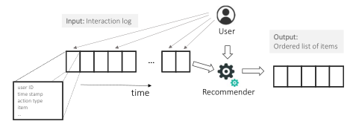
Sequential Recommendation
Outputs
Inputs are different from matrix completion
Outputs are the same, i.e., a ranked list of items

Slide 86
Sequential Recommendation
Categorization
Sequential recommendation
The general problem of making next-item recommendations, e.g., a Point of Interest in tourism
Session-based recommendation
Also next-item recommendations, but assumptions
past data is organized in sessions
Recommendations to be made in an ongoing session
Needs may change from session to session
Often, no long-term preference profiles are available, recommendations based on a few interactions

Slide 87
Sequential Recommendation
Categorization, continued
Session-aware recommendation
Also based on sessions
But with user IDs (and long term profiles) available
Also called personalized session-based recommendation
Generally
The literature is not consistent in terms of terminology
Sequential and session-based recommendation often conflated

Slide 88
Sequential Recommendation
Algorithms
Categorization
Sequence Learning Approaches
Sequence-Aware Matrix Factorization
Hybrid Approaches
Nearest Neighbors and Other Methods

Slide 89
Sequential Recommendation
Sequence Learning Approaches
Frequent Pattern Mining:
Historically used for finding (unexpected) patterns in shopping baskets
Learning of association rules or sequential rules
Sequence Modeling:
Go beyond mined patterns and apply various ML models, e.g., based on Markov Models, Reinforcement Learning, or Deep Learning; often as RNNs and other models from Natural Language Processing (NLP) Sequential Recommendation

Slide 90
Sequential Recommendation
Sequence Learning Approaches
Distributed Item Representations
Also encode sequential information
Representations (embeddings) as projects from sequences of item-related events into a lower-dimensional representation; where transitions between items are preserved
Supervised Learning with Sliding Windows
Models sequential learning as supervised learning
Moving a sliding window over a sequence of events
Derive feature values to predict next event

Slide 91
Sequential Recommendation
Sequence-Aware Matrix Factorization
Extend MF to consider sequentiality, based on timestamps in the user-item interaction matrix
Conceptually related to time-aware RS
Hybrid Approaches
Combine sequence modeling with latent factor models
Factorized Personalized Markov Chain approach as an example
models user-specific item predictions
Recently, neural models combined

Slide 92
Sequential Recommendation
Nearest-Neighbors and Other Methods
Nearest Neighbors
In particular applied for session-based recommendation
Find sessions from the past that are similar to the current one and make predictions based on those
Conceptually simple but highly effective
Other methods
Only a few examples in the literature, e.g., based on optimization techniques
These may suffer from scalability issues

Slide 93
Sequential Recommendation
Evaluation of Sequential Recommendations
In many ways similar to traditional problem setting
Some specific tasks may however exist
Context adaptation: Central to session-based problems, i.e., guess the user’s situation and intent
Trend detection: Both at the individual and global level
Repeated recommendation: Not considered in matrix completion setups, but useful in practice (e.g., reminders)
Considering order constraints and patterns: For domains, where a strict order exists (e.g., learning course recommendation, movie sequels)

Slide 94
Sequential Recommendation
Offline evaluation
Output is (as usual) a ranked list of items
Hide-and-predict evaluation approach can be applied, using, e.g., precision and recall
Train-test-splitting can however not be done entirely randomly
Sequential order must be considered
Common in sequential recommendation: Hide the last element per user
Common on session-based recommendation: Perform a time-based split
Using, e.g., the last few days for testing

Slide 95
Sequential Recommendation
Offline evaluation
Measuring accuracy metrics in session-based recommendation, variations:
Hide-and-predict the last element
or
Incrementally reveal item per item in a test session
Only check if the immediate next item is in top-n list
or
Compute overlap of recommendations with rest of the session

Slide 96
Sequential Recommendation
Offline evaluation
What to measure
Beyond-accuracy metrics, e.g., diversity can be applied as well
What to predict
Most works predict the next item-view events (which is the most frequent type of event)
Predicting the next purchase event may be more relevant
What to consider
Most approaches only use view events
Potential of using use side information
Potential of use other user events (add-to-cart etc.)

Slide 97
Sequential Recommendation
User-centric evaluation
Almost no studies involving users
Examples: Studies in the music domain, e.g., on
the perceived quality of next-track recommendations for a given music playlist
the perceived quality of recommendations provided by an automated (interactive) radio station
Questions of the alignment of offline metrics and human perceptions
Frameworks for user-centric RS evaluation can be applied

Slide 98
Sequential Recommendation
Real-world evaluation
Not too many reports of real-world deployments available yet
Example
A study in the home improvement domain
Ranges from offline evaluation over expert/user evaluation to live A/B test
Nearest-neighbor approach performing well in offline tests
In the end, recommendations of a neural model were however found to be more suitable for the given application

Slide 99
Popularity, Bias and Recurrence
Observations since 2010
Algorithms get rewarded by recommending popular items in offline evaluation
Popularity distribution of items is highly skewed
long-tail shape
When random splitting the data
More training data exist for popular items, and they appear more frequently in the test set than others
Ranking popular items highly, we get fewer missing ratings in the top-n positions, leading to higher relevance metrics
Many popular CF algorithms are thus biased to recommend popular items

Slide 100
Popularity, Bias and Recurrence
Resulting research directions
Avoiding or countering the bias
both in algorithms and evaluation
Better understanding where the bias comes from
wondering whether it is harmful or useful in a given context of use

Slide 101
Popularity, Bias and Recurrence
Countering bias
Popularity may be considered undesirable from a value-creation perspective
Also stands in contrast with the novelty perspective
Relevance and novelty still have to be combined
Specific evaluation procedures were designed
To remove bias from the metrics
To remove bias from the algorithms
Counterfactual reasoning approaches as an alternative active area of research
Downweighting observed preferences for popular items

Slide 102
Popularity, Bias and Recurrence
Understanding bias
Popularity bias not necessarily harmful
Considering popularity signals may in fact be helpful
Netflix reports to add a “healthy dose of popularity” to their recommendations
Recent developments in better theoretical understanding how to leverage the important signal for improved recommendations
While mitigating possible distortions

Slide 103
Popularity, Bias and Recurrence
The feedback loop
Major source of the bias lies in how the data is collected on real-world sites
If a recommendation system is in place, its recommended items will receive more attention and interactions
These will be fed back to the system as inputs
In sum, this leads to a magnification effect
aka Snowball effect, Matthew effect, rich-get-richer
In the end, the system is stuck in own assumptions, missing opportunities to recommend certain items

Slide 104
Popularity, Bias and Recurrence
The feedback loop
May lead to perverse incentives in real-world deployments
Focusing on certain highly-popular (including controversial) items may lead high user engagement, which often is associated with short-term revenue
Blindly targeting such items my lead to compulsive or toxic behavior
May hurt long term business performance
May lead to toxic phenomena
Misinformation spreading, polarization, radicalization
Thus, such phenomena need close attention

Slide 105
Popularity, Bias and Recurrence
The feedback loop – reinforcement learning
Reinforcement learning as one promising approach to break the feedback loop
Algorithm aims to please and learn simultaneously
Recommendation seen as opportunity to both:
match user interests to the current system knowledge
extend the knowledge by exploring unexplored areas
Thus, both the short-term and long-term perspective are considered (exploration and exploitation)
Most traditional research, in contrast, only looks at the once-in-a-lifetime interaction with the user

Slide 106
Popularity, Bias and Recurrence
The feedback loop – reinforcement learning
Multi-armed Bandit (MAB)
Items seen as actions to be selected
Actions return a reward when chosen (utility/value for the user)
Goal is to maximize cumulative rewards over time
MAB algorithms break the loop, loosely speaking by a bit of informed randomness
Personalization is implemented through contextual variants, where the context includes the user, and the reward depends on the context

Slide 107
Popularity, Bias and Recurrence
Summing up
Popularity bias may arise from a feedback loop and different mutually-enforcing effects
Novelty-enhancement techniques, bias countering and reinforcement learning as promising approaches
Targeting at a healthy degree of explorations in the recommendations

Slide 108
Popularity, Bias and Recurrence
The feedback loop
Markov Decision Process (MDP) as another general modeling approach
Models the effects of recommendations on the user’s state
Also a natural fit for sequential problems
MDP requires large amounts of data to be effective
Addressed by complementary offline training, where however biases must be considered

Slide 109
Impact and Value of RS
RS have been successfully applied in practice in various application settings for decades
The value for consumers and business is undisputed
Academic research however mostly not based on studies with deployed systems
Data-centric offline experiments are predominant
Mostly on better prediction models
Questions that are not asked much in academia
“What made a recommendation successful?”
“Are popular items, when recommended, more likely to be purchased by users?”

Slide 110
Impact and Value of RS
Accuracy addition
Common assumption: higher (offline) accuracy directly leads to better recommendations
As assumedly more relevant items appear higher in the ranked lists
In reality, higher accuracy only sometimes leads to a better quality perception by users
And, it is less than certain that higher offline accuracy (on past data) leads to better value for consumers or providers

Slide 111
Impact and Value of RS
The problem with accuracy, illustrated
Assume a user who loved the first two Avenger movies, and rated them highly
An algorithm that recommends three more Avenger movies, will probably have 100% accuracy
But the value may in fact be zero (or negative)
The user would have watched these movies anyway, and may find the recommendations monotone
The provider could have used the opportunity to promote some other movies
We need to move beyond offline accuracy evaluation

Slide 112
Impact and Value of RS
Understanding impact w. humans in the loop
Questions to ask
Would users find the recommendations provided by a system useful?
Would they find them novel, diverse, or entertaining, and would they ultimately be satisfied with the recommendations?
Would they believe that the system’s recommendations are trustworthy, would they like to see an explanation?
Will they consider the system’s recommendations in their decisions in the future?
These aspects may influence if a user accepts a recommendation

Slide 113
Impact and Value of RS
Understanding impact w. humans in the loop
The asked questions cannot be answered with typical offline experiments
Recommendation is – to a large extent – a problem of human computer interaction
Studies that involve humans are necessary to understand these aspects
Most common form: Experiments in the form of a randomized controlled trial (RCT)

Slide 114
Impact and Value of RS
Randomized Controlled Trials (RCT)
Participants are randomly assigned to either a control group or to one more treatment groups
Common in many studies in the literature:
Users interact with different version of a prototype system
Study is done in a controlled environment, e.g., in a lab
Users accomplish a set of predefined tasks
Design of study depends on research question / hypothesis
Has to be defined in advance, “theory development”

Slide 115
Impact and Value of RS
Randomized Controlled Trials (RCT)
Example scenario: Effect of explanations on users’ decision effort and trust in the system is investigated
Control group does not receive explanations, treatment group receives explanations
Many detailed design choices to be made here
Participants are instructed to provide preferences, select a recommendation, fill out a questionnaire about their perception of the system in various dimensions
e.g. relevance of recommendations, perceived effort, trustworthiness of the system

Slide 116
Impact and Value of RS
Randomized Controlled Trials (RCT)
Example scenario:
Hypothesis in advance: The provision of explanations has a positive effect on the perceived trustworthiness of the system, but increases the decision effort
Establish independent and dependent variables
Collect data
Through questionnaire
And/or through observing the user’s behavior and choices, e.g., mouse clicks, decision time
After data collection
Apply statistical analysis to assess if explanations are likely to have influenced the dependent variables

Slide 117
Impact and Value of RS
Research based on user experiments:
Research is guided by underlying hypothesis, often based on theoretical consideration
Each study typically requires a specific design
Flaws in the design require a re-execution of the entire study with an improved design
Need to involve representative study participants
Recently, crowdworkers are often involved
In sum:
Such user studies are often more effortful than offline experiments

Slide 118
Impact and Value of RS
User experiments – frameworks
Ambitions to make such studies standardized to some extent
Pre-defined hypothesized relationships between variables
Pre-defined and validated questionnaires
One example: The ResQue Framework
“Recommender Systems Quality of User Experience”
Inspired by the Technology Acceptance Model (TAM)

Slide 119
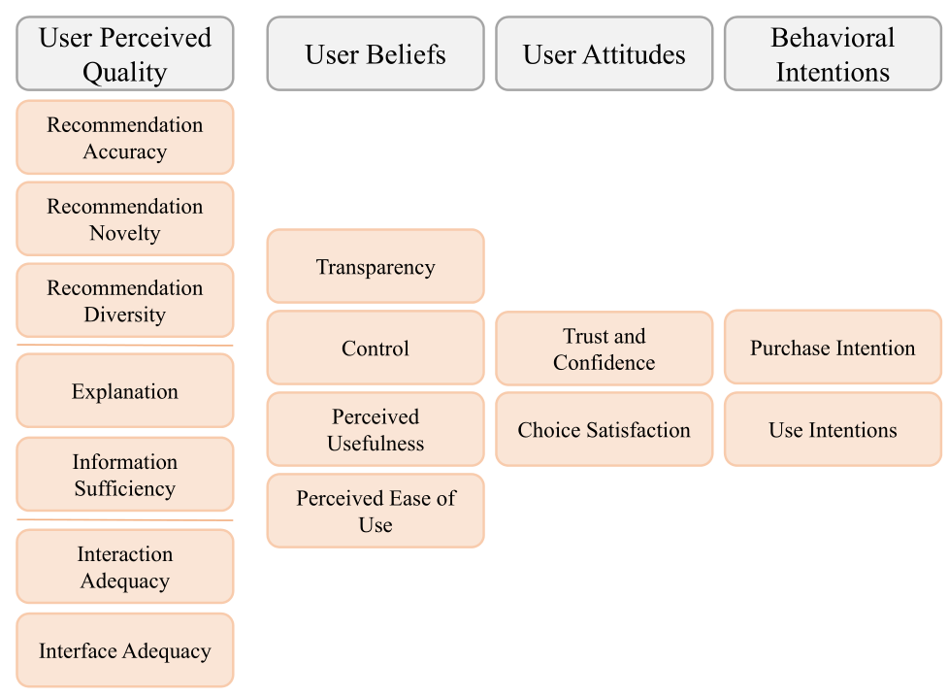
Impact and Value of RS
The ResQue Framework

Slide 120
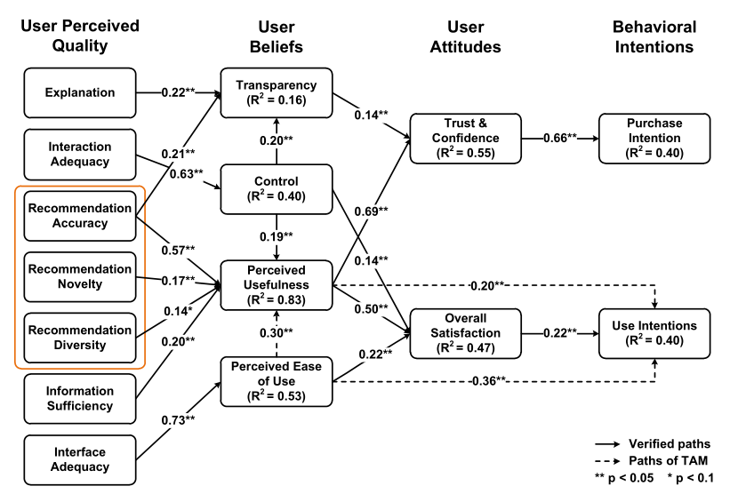
Impact and Value of RS
ResQue – path analysis outcome

Slide 121
Impact and Value of RS
User experiments, in sum
Can inform us about important aspects that cannot be answered by offline experiments
In particular when it comes to the user experience
Should be used as an instrument more often
Have their limitations
As participants are not interacting with a real system and are not real making, e.g., purchase decisions
Other forms of user-centric studies exist
e.g., qualitative studies (focus groups and interviews), observational studies

Slide 122
Impact and Value of RS
Consumer and business value
Literature focuses on consumer value
e.g., reduced information overload or improved discovery
Assuming this is at least indirectly beneficial for providers
e.g., more engagement through discovery leads to lower customer churn
Consumer and provider goals may however be not aligned
Leading to a multi-stakeholder recommendation problem

Slide 123
Impact and Value of RS
A multi-stakeholder optimization problem
Different involved entities
Consumers or End Users: Recipients of the recommendations, individuals or groups
Recommendation Service Providers: Organizations that are in control of the RS, which they run as part of their business
e.g. online retailers, streaming service providers
Suppliers: Entities that create or provide the items that can be recommended, e.g., manufacturers; can also be the same as the RS service providers
Society: RS may affect a larger fraction of society, e.g., news feed recommendations on global-scale social networks

Slide 124
Impact and Value of RS
Multi-Stakeholder Challenges: Example
Hotel search service charges commission fee to hotel owners per booking
Consumer perspective
Best recommendation satisfies specific needs, observing budget constraints
Service provider wants to maximize commission fees
Recommender might want to prioritize hotels that reasonably match customer needs, but maximizes profit
At the same time, the provider wants to ensure that all hotels are recommended from time to time, so that the platform remains attractive for owners
The hotel chains, finally, may have an interest that certain hotels are promoted through recommendations, for example expensive ones

Slide 125
Impact and Value of RS
Multi-stakeholder recommendation
Today, research is still limited
Partly in price and profit aware recommender systems,
in reciprocal recommendation (jobs, dating),
and in fairness-oriented research
Challenges:
Limited availability of data (e.g., about price and profit)
Existing evaluation approaches focus mostly on accuracy
Perspective:
Relying on simulation approaches, also to capture longitudinal aspects

Slide 126
Impact and Value of RS
Impact and Value Oriented Recommender Systems Evaluation
In practice, various Key Performance Indicators (KPIs) are relevant
Depending on the purpose of the system and the business model of the provider
Common KPIs from the literature
Click-through-rates (CTR): Common in ad-based business models. Optimizing for CTR might be short-sighed in recommender systems
Adoption and Conversion: Goes beyond counting clinks, and measure if a recommendation was successful, e.g., if they made a purchase or watched a recommended movie

Slide 127
Impact and Value of RS
Common KPIs from the literature
Sales and Revenue: The most direct measurement, focus on the additional sales generated by the RS
Effects on Sales Distributions: Measuring effects on user (choice) behavior, e.g., if users are persuaded to select different options by the RS
User Engagement: Commonly used to assess long-term customer loyalty/retention. Higher interaction indicates future visits or service renewals

Slide 128
Impact and Value of RS
Research dilemma
Choice of metrics depends on idiosyncrasies of the application context
Academic research is interested in generalizable approaches
Optimizing for accuracy, as commonly done, is plausible, but may represent an oversimplification, as discussed
Outlook
Proposal of a purpose and value-oriented framework to guide researchers in industry and academia
Ensuring that the used metrics are aligned with the intended system purpose

Slide 129
Impact and Value of RS
A purpose oriented framework
Considers consumer and provider perspective
Four main layers
Overarching goals: e.g., consumer satisfaction, provider revenue
Purpose of the recommender: e.g., help users explore the item space, create additional demand
Computational task: e.g., find good items, find suitable accessories
Evaluation approach: predictive accuracy, beyond-accuracy measures, satisfaction scores
Important observations
Relying solely on offline experiments can be too limiting

Slide 130
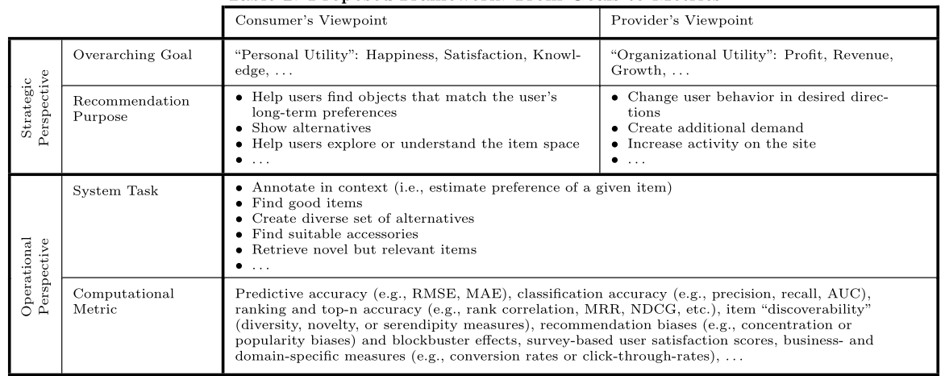
Impact and Value of RS
A purpose oriented framework

Slide 131
Impact and Value of RS
Paradigm shift is needed:
More often rely on a purpose-oriented approach to align purpose and evaluation approaches
Consider a multi-method research approach, including also human-in-the-loop evaluations, using experiments and qualitative research methods
Generally expand the methodological repertoire, considering improved data analytics and simulation
Consider domain- and application specifics more often, acknowledging that there is no “best model”
One set of recommendation can be good in one situation and bad in another
Adoption of the Information Systems perspective of RS

Slide 132
Future Directions (subjective selection)
Conversational Recommendations
Recent developments in natural language processing and machine learning in general open new opportunities
New opportunities for interactive, chat-bot like forms of interactions
Large Language Models like (Chat)GPT as a recent game changer
High quality system responses
Accurate intent detection
High-quality recommendations in popular application domains, e.g., movies

Slide 133
Future Directions
Questions of fairness and ethical concerns have grown in general with the AI boom
Also recommender systems may lead to fairness questions
Recommendations can influence the success of an artist in Spotify, a seller on Amazon, a job candidate on LinkedIn and so forth
Recommenders are widely used mediators between providers and consumers
Recommendations thus must be done in a responsible fashion
Recent research interest in the topic
Challenged by the complexity of defining and operationalizing fairness

Slide 134
Future Directions
Challenges of offline/online misalignment
Offline evaluation results often not aligned with outcomes of A/B tests
Multiple causes are possible
metric mismatch, bias in the offline data, interference from external components when recommendation techniques are only part of a complex recommendation pipeline
This makes the value of improvements, e.g., in offline accuracy, questionable
This is a fundamental problem of much of the published literature
Bringing offline evaluation closer to a measure of the final effect of recommendations of utmost importance

